Slide 1
Chromatic Aberration and What It Could Mean To You.
Chromatic Aberration and What It Could Mean To You.
Chromatic Aberration and What It Could Mean To You.
Often we want to image (and measure) the location of different color proteins inside cells. XY registration is easy, but it is not so simple in Z.
Michael Cammer Dec. 2011

Slide 2
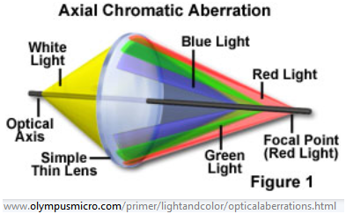
Different λ of light focus at different Z axis positions

Slide 3
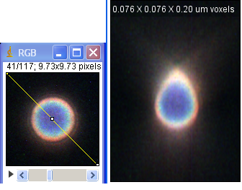
150X Olympus objective well corrected
Emissions from 500 to 670 nm.
4umbeads_150X_Z020_XZ

Slide 4
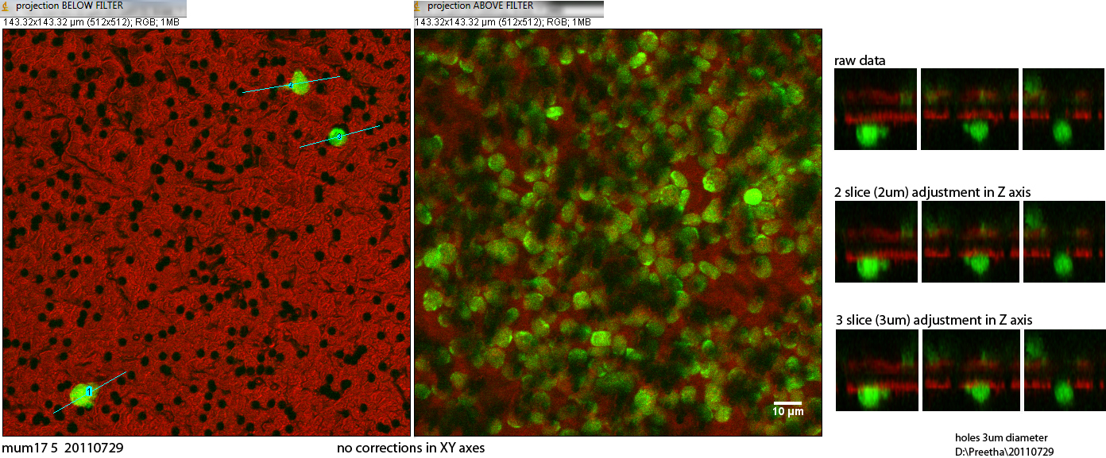
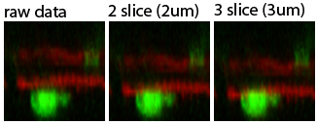
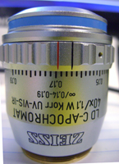
Example with transwell assay
http://cammer.net/mld/instructions/710/transwellassays/index.html

Slide 5
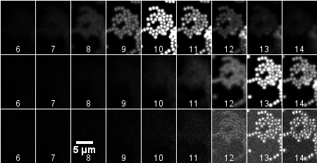
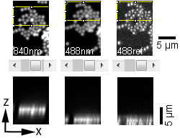
How to calibrate
This is caused by chromatic aberration. The reflection is at 488 nm and the multiphoton excitation is at 840 nm.
Based on measurements with beads, the focal point from one to the other wavelength shifts by approximately 3 um.

Slide 6
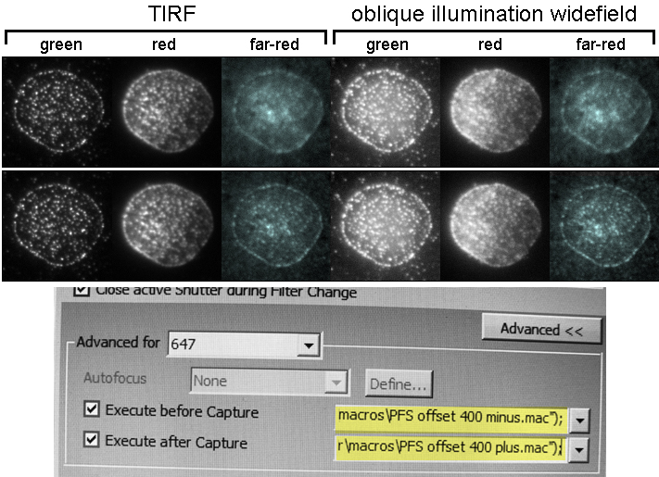
Chromatic aberration a problem in TIRF too
Notes:
TOP no focus shift
BOTTOM 400 nm shift
Spatial scale: Cell diameter approx 6 um.

Slide 7
Chromatic aberration a problem in TIRF too
Detailed instructions at
http://cammer.net/mld/instructions/nikon/focus/index.html
Notes:
TOP no focus shift
BOTTOM 400 nm shift

Slide 8
Conclusion
When doing precise colocalization, need to check the offset of different wavelength probes along the optical axis.
When taking single optical section pictures of different probes, need to adjust focal planes appropriately.

